Slide 1
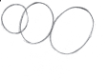
1
Draw 3 circles

Slide 2
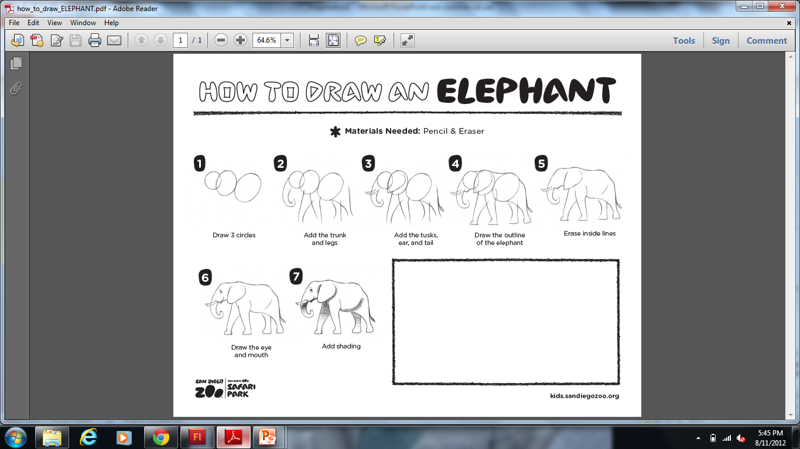
2
Add the trunk and legs

Slide 3
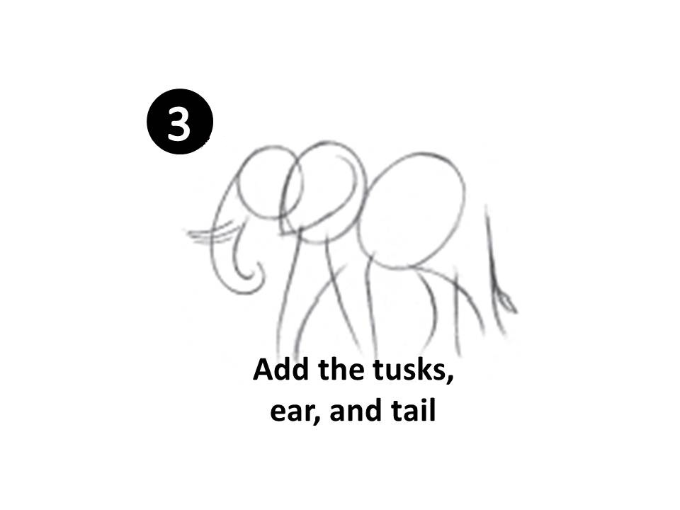
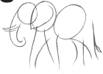
3
3
Add the tusks, ear, and tail

Slide 4
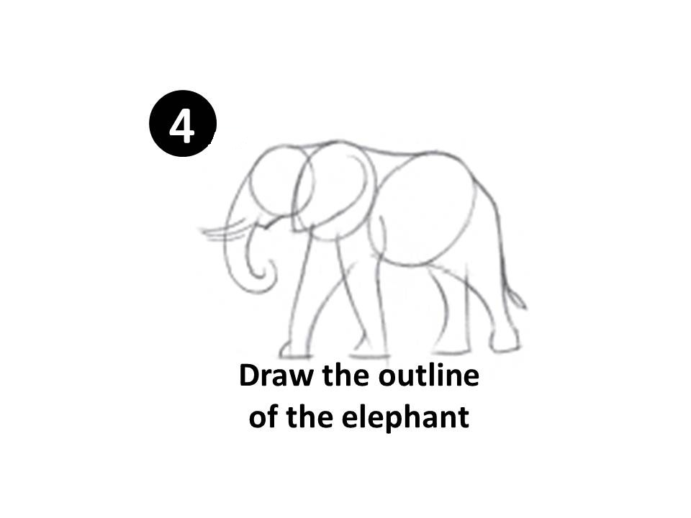
4

Slide 5

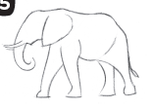
5
5
Erase inside lines

Slide 6

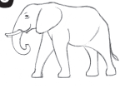
6
6
Draw the eye and mouth

Slide 7
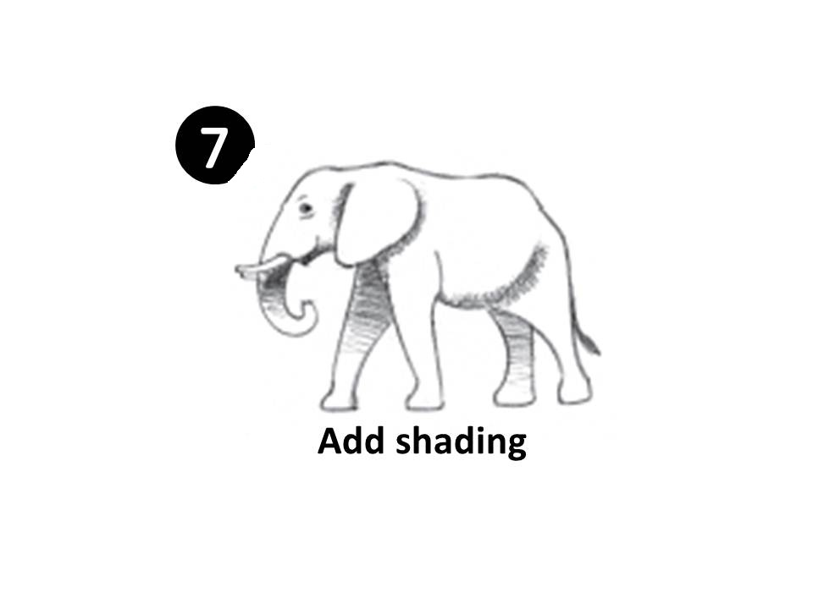

7
7
Add shading

